Slide 1
Welcome to Willows
September 2023

Slide 2
Outline of this session: - to meet your child’s new class teacher - to share routines and expectations - information about how you can help support at home - how you can get in touch with us

Slide 3
Current position of school
The school went through a very rigorous Ofsted inspection in April and retained our ‘Good’ judgement.
In terms of data, the EYFS data is the strongest it has ever been and above local and national figures.
Year 4 Multiplication scores were significantly above national figures.
Outcomes at Key Stage 1 and Key Stage 2 are also very strong, with really good progress across Key Stage 1, and were at least in line with local and national figures and in some areas above.
We are in a great position to build on these successes this year!

Slide 4
School Priorities for 2023/24
To continue to improve writing outcomes for all children.
To develop oracy across the school.
To refine the mapping and development of the foundation subjects.

Slide 5
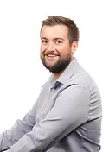
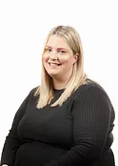
Meet the Team
Mr Baldwin
Class Teacher
Miss Calister
Teaching Assistant
Monday Morning
&
Wednesday Morning
Mr Hanlon
PPA Cover
Thursday Morning

Slide 6
Routines:
8.40 am – Mrs Bamforth will open the gates. Children to come to their classroom (Early Morning Task)
9am – 10 am Session 1
10.00 am to 10.15 am Daily Assembly
10.15 (X tables and Spelling)
KS2 10.35am – Playtime
KS2 10.50am – SQUIRT/Class Reading
11.15am – Session 2
12.15 pm – Lunch time
1pm – Foundation subjects/daily mile
3.15pm – Home time - children will be brought to the playground. Please note, only Year 6 can walk home and this needs to be confirmed in writing please.

Slide 7
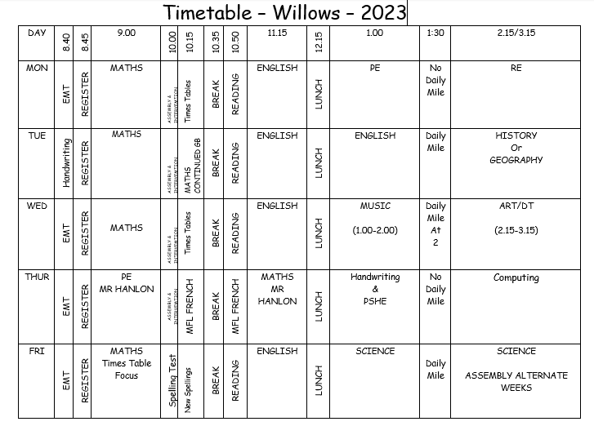

Slide 8
Expectations
Class Charter
Our classroom is an exciting environment for learning and thrilling discovery. We learn with great enthusiasm and spirit. We are talented, honest pupils who support each other through our actions and words. In Willows we face challenges with
resilience and self-belief. We embrace the magic moments, and we aim to be outstanding role models for Ripponden J&I School!

Slide 9
Equipment needed:
Indoor and outdoor PE kit – Monday-Thursday
Trainers – daily
Water bottles – daily
Reading books – Children can take up to 2 books home every day. A class library book and a Banded Book.
PLEASE LABEL EVERYTHING

Slide 10
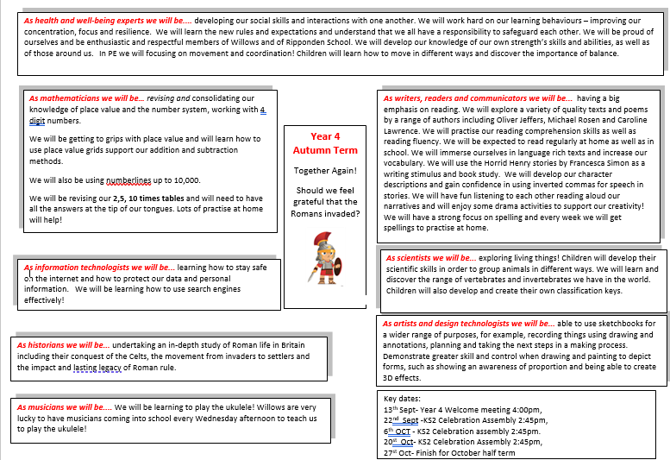
Curriculum Coverage

Slide 12
How you can help
Supporting with homework
Reading with your child – every day please!
Visiting the website for links
http://www.ripponden.calderdale.sch.uk/
Talking to your child about their learning
Keeping the lines of communication open – we have an open door policy and are here to help and support your child and your family where we can.

Slide 13
Medical/health needs
We hold a medical and health care needs register in school and this is treated with the strictest of confidence.
If your child has a medical need that we don’t know about, or if these needs change, please let us know as soon as possible. Please also make sure in date medication is sent into school.
To let us know, please email office@ripponden.calderdale.sch.uk for the attention of Miss Smith.

Slide 14
Any questions?
We are delighted to be able to meet face-to-face again. Please do ask if you have any questions.
If you have any questions about any of this, please get in touch with the office:
office@ripponden.calderdale.sch.uk
and a member of staff will get back to you as soon as possible.

