Slide 1
Welcome to Maples
September 2023

Slide 2
Outline of this session: - to meet your child’s new class teacher - to share routines and expectations - information about how you can help support at home - how you can get in touch with us

Slide 3
Current position of school
The school went through a very rigorous Ofsted inspection in April and retained our ‘Good’ judgement.
In terms of data, the EYFS data is the strongest it has ever been and above local and national figures.
Year 4 Multiplication scores were significantly above national figures.
Outcomes at Key Stage 1 and Key Stage 2 are also very strong, with really good progress across Key Stage 1, and were at least in line with local and national figures and in some areas above.
We are in a great position to build on these successes this year!

Slide 4
School Priorities for 2023/24
To continue to improve writing outcomes for all children.
To develop oracy across the school.
To refine the mapping and development of the foundation subjects.

Slide 5
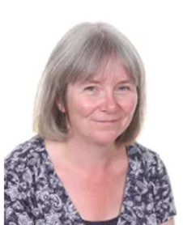
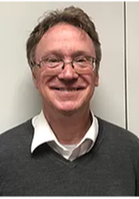
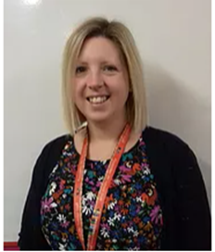
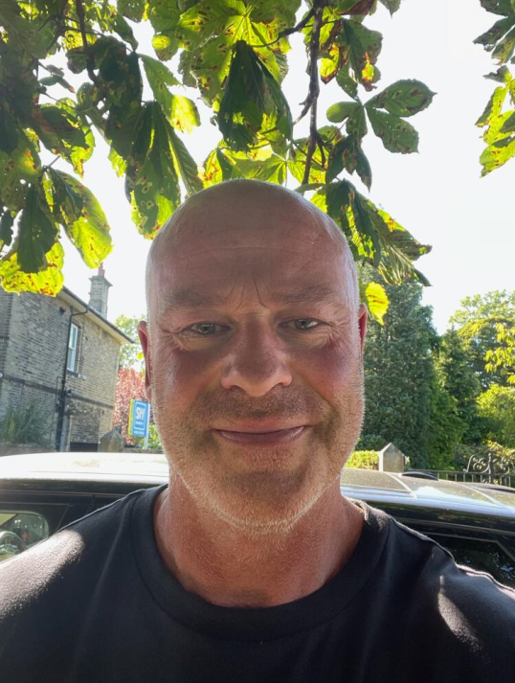
Meet the Team
Mrs Bolton
Class Teacher
(Th/Fr)
PPA Cover
Mr Hanlon
Mrs Thompson
Mrs Coneron
Weds swimming
Mrs Bamforth
Friday 8.40 – 10am
Mrs Whitaker
(Mon – Weds)
VACANCY
(6 lessons)
Teaching Assistant
Mr Philps
Support Assistant

Slide 6
Routines:
8.40 am – Mrs Bamforth will open the gates. Children to come to their classroom (Early Morning Task)
9am – 10 am Session 1
10.00 am to 10.15 am Daily Assembly
10.15 (complete Session 1)
KS2 10.35am – Playtime
10.50am – SQUIRT/Class Reading
11.15am – Session 2
12.15 – Lunchtime (with lunch at 12.30)
1.00 – Session 3
2.15 – Daily Mile
2.30 – Session 4
3.15pm – Home time - children will be brought to the playground. Please note, only Year 6 can walk home and this needs to be confirmed in writing please.

Slide 7
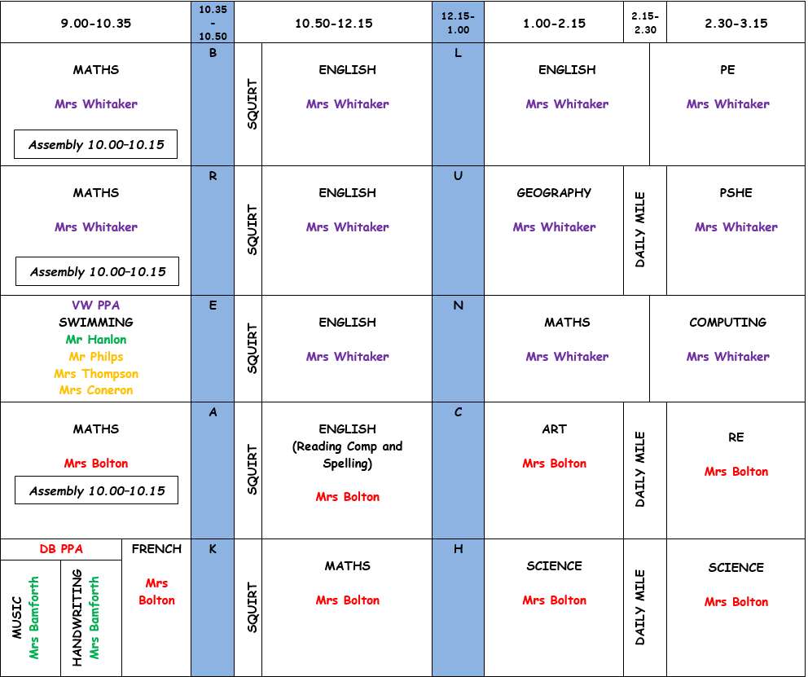
Timetable: Autumn 1

Slide 8
Expectations

Slide 9
Maples’ Class Charter

Slide 10
Equipment
Reading book and reading record every day
Homework folder every day, handing in homework on Tuesdays
Water bottle (that doesn’t leak!)
Trainers every day, in a boot bag / carrier bag
Swimming kit on Wednesday
PE kit every day, but PE lesson is on Monday
All stationary is provided by school.
A waterproof coat

Slide 11
Curriculum Coverage
Continued on the next slide…….

Slide 12
Curriculum Coverage

Slide 13
Curriculum Coverage

Slide 14
Homework
Wednesday: Maths (Mrs W)
Thursday (Mrs B)
BOTH DUE IN ON TUESDAY
Reading – daily
(Class text from Easter)

Slide 15
How you can help
Supporting with homework
Reading with your child – every day please!
Visiting the website for links and news
http://www.ripponden.calderdale.sch.uk/
Talking to your child about their learning
Keeping the lines of communication open – we have an open-door policy and are here to help and support your child and your family where we can.

Slide 16
Medical/health needs
We hold a medical and health care needs register in school and this is treated with the strictest of confidence.
If your child has a medical need that we don’t know about, or if these needs change, please let us know as soon as possible. Please also make sure in-date medication is sent into school.
To let us know, please email office@ripponden.calderdale.sch.uk for the attention of Miss Smith.

Slide 17
Any questions?
We are delighted to be able to meet face-to-face again. Please do ask if you have any questions.
If you have any questions about any of this, please get in touch with the office:
office@ripponden.calderdale.sch.uk
and a member of staff will get back to you as soon as possible.

