Slide 1
Welcome to Willows
September 2024

Slide 2
Outline of this session: - to meet your child’s new class teacher - to share routines and expectations - information about how you can help support at home - how you can get in touch with us

Slide 3
Current position of school
We had a great year last building on lots of successes.
Data in all statutory areas – EYFS, Year 1 phonics check, Year 4 multiplication check and end of KS2 SATs results were all above local and national figures. This is a really strong position to be in.
We also engaged with lots of activities beyond the National Curriculum, including achieving The Healthy Schools Award at Platinum Level!
From these successes, we are in a fantastic position to build and continue to improve!

Slide 4
School Priorities for 2023/24
To continue developing and refining our curriculum offer to best meet the needs of all children.
To develop oracy across the school, to foster articulate and well-rounded children, able to speak and write in a variety of contexts.
To develop and refine transcription skills in the younger years, to enhance the writing process throughout the school.

Slide 5
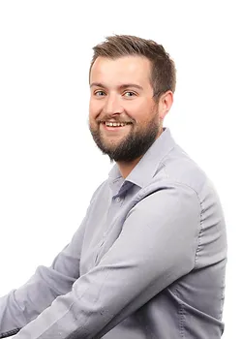
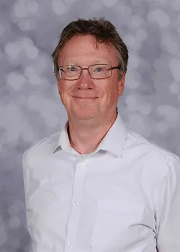
Meet the Team
Mr Hanlon
PPA Cover
Friday Mornings
Mr Baldwin
Class Teacher

Slide 6
Routines:
8.40 am – Mrs Bamforth will open the gates. Children to come to their classroom (Early Morning Task)
9am – 10 am Session 1
10.00 am to 10.15 am Daily Assembly
10.15 (X tables and Spelling)
KS2 10.35am – Playtime
KS2 10.50am – SQUIRT/Class Reading
11.15am – Session 2
12.15 pm – Lunch time
1pm – Foundation subjects/daily mile
3.15pm – Home time - children will be brought to the playground. Please note, only Year 6 can walk home and this needs to be confirmed in writing please.

Slide 7
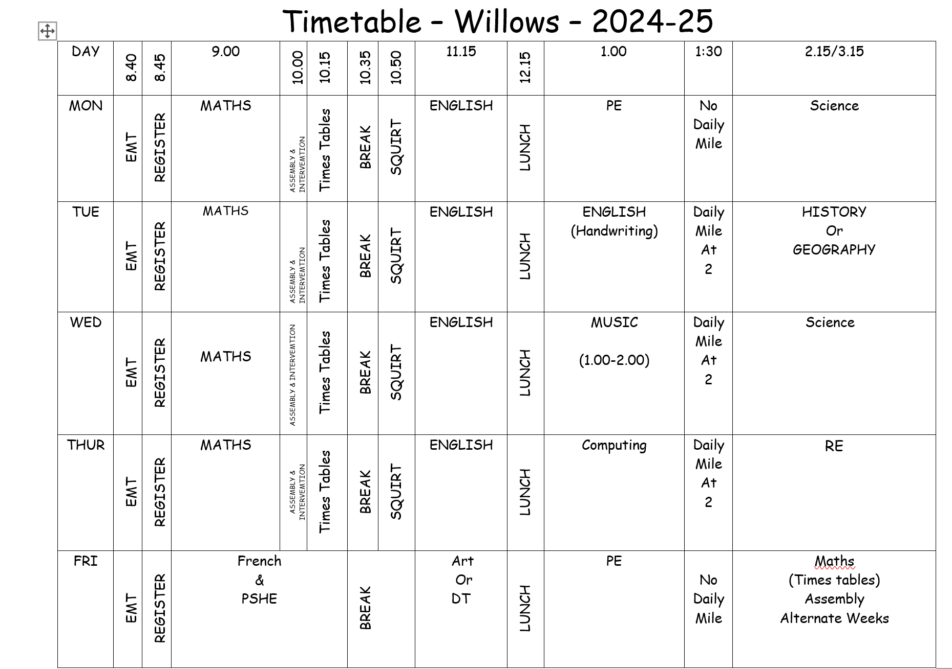
Timetable

Slide 8
Expectations

Slide 9
Equipment needed:
Indoor and outdoor PE kit – Monday-Friday
Trainers – daily
Water bottles – daily
Reading books – Children can take up to 2 books home every day. A class library book and a Banded Book.
PLEASE LABEL EVERYTHING

Slide 10
Curriculum Coverage

Slide 12
How you can help
Supporting with homework
Reading with your child – every day please!
Visiting the website for links
http://www.ripponden.calderdale.sch.uk/
Talking to your child about their learning
Keeping the lines of communication open – we have an open-door policy and are here to help and support your child and your family where we can.

Slide 13
Medical/health needs
We hold a medical and health care needs register in school and this is treated with the strictest of confidence.
If your child has a medical need that we don’t know about, or if these needs change, please let us know as soon as possible. Please also make sure in date medication is sent into school.
To let us know, please email office@ripponden.calderdale.sch.uk for the attention of Miss Smith.

Slide 14
Any questions?
We are delighted to be able to meet face-to-face again. Please do ask if you have any questions.
If you have any questions about any of this, please get in touch with the office:
office@ripponden.calderdale.sch.uk
and a member of staff will get back to you as soon as possible.

